Slide 1
PITCH DECK
MINDWISE BOT
GROUP 28
AI FOR SOFTWARE ENGINEERING
MEMBERS
SPARROW MANOTI
ERIC KINYAJUI
MARY NJENGA
ANNIE KIRUJA
GEORGE KELLY

Slide 2


WELCOME NOTE
“You are not alone. It's okay to ask for help”
Welcome to MindWiseBot, an AI-powered mental health companion.
Promoting well-being for all, in support of SDG 3.

Slide 3
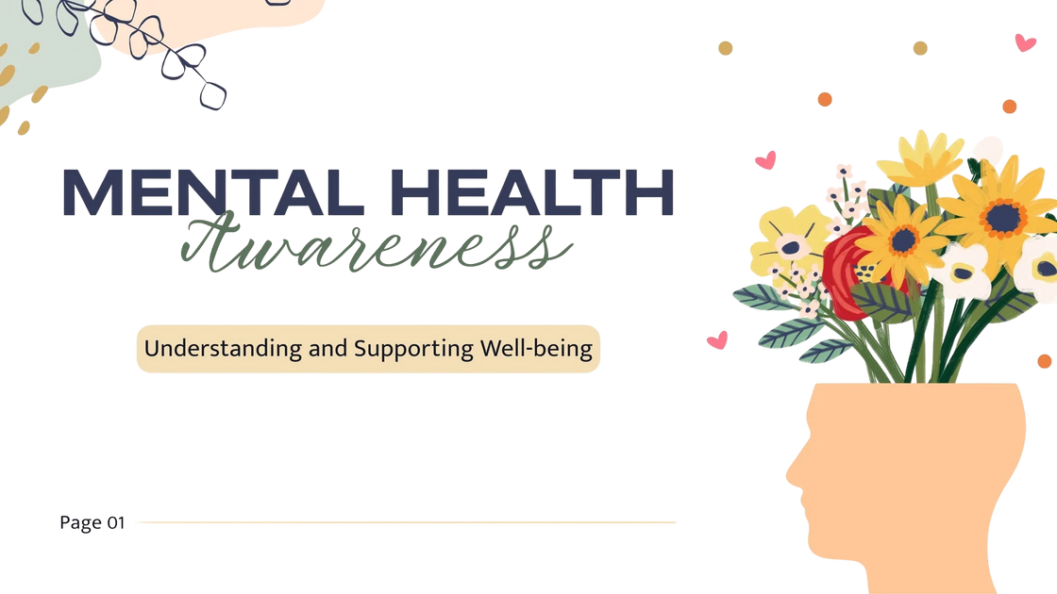

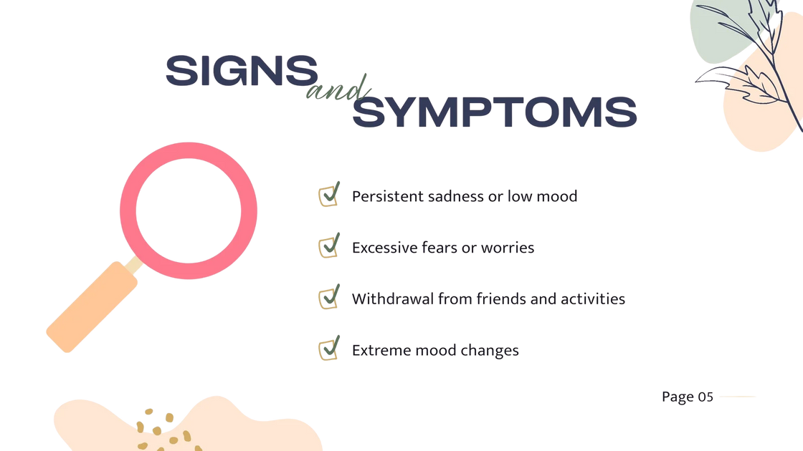
THE PROBLEM
1 in 8 people globally live with mental health conditions.
But most don’t receive help due to:
Stigma
Lack of access to mental health services
Cost and unavailability of trained professionals
This leaves millions, especially youth and underserved communities, suffering in silence.

Slide 4
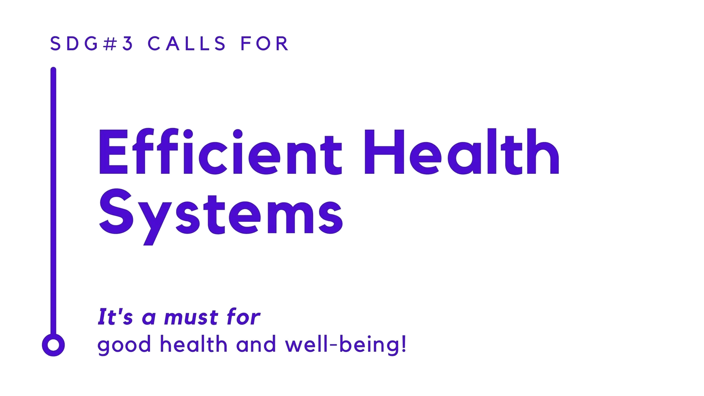
SDG CONNECTION
Goal 3: Good Health & Well-being
Target 3.4: “By 2030, promote mental health and well-being.”
MindWiseBot supports this by:
Providing safe, stigma-free conversations
Sharing coping strategies & emotional support
Connecting users with resources and self-help tools
“Your feelings are valid. Take it one moment at a time.”

Slide 5



Communities with limited access to mental health services
NGOs and schools promoting mental wellness
TARGET AUDIENCE
Youth and students
Working professionals
Teachers and caregivers
Communities with limited access to mental health services
NGOs and schools promoting mental wellness
Youth and students
Working professionals
Teachers and caregivers

Slide 6
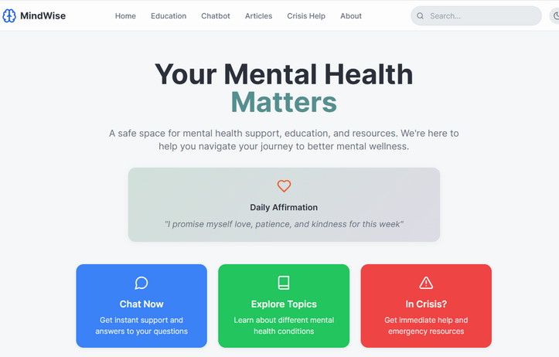
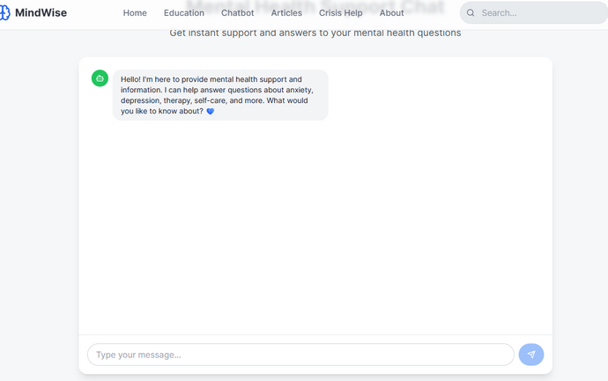
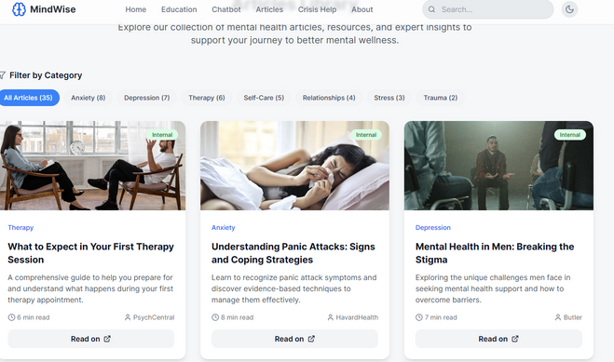
AI-powered empathy: NLP-driven responses tailored to emotions
Anonymous and stigma-free: No sign-up required
Accessible UI: Clean, mobile-friendly design
SDG-Based Framework: Informed by UN mental health priorities
Customizable prompts: From stress and anxiety to daily motivation
OUR PRODUCT/FEATURES
HOME FEATURE
CHATBOT FEATURE
ARTICLES FEATURE

Slide 7


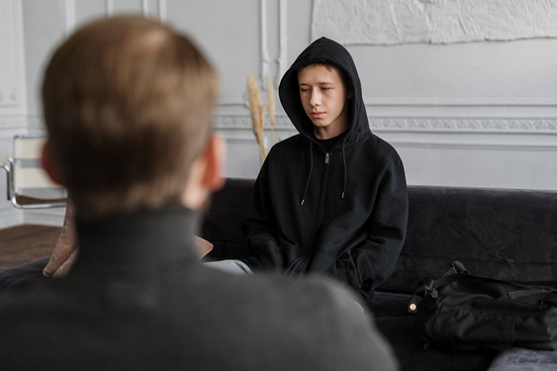
MindWise Bot is a friendly AI chatbot that:
Offers empathetic, judgment-free conversations
OUR SOLUTION
Shares wellness tips, grounding exercises, and affirmations
“A pocket-sized companion for mental wellness.”
Connects users to mental health resources
Operates 24/7 — private, stigma-free, and accessible

Slide 8

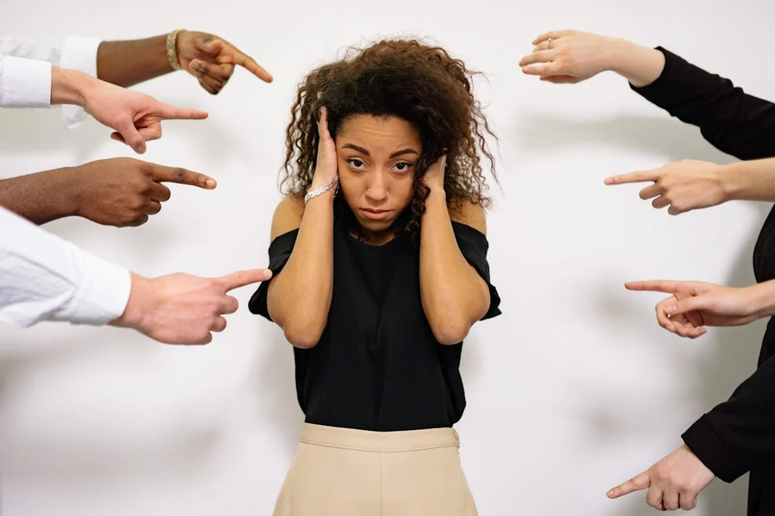
IMPACT GOALS
By 2030, we aim to:
Reach 1M+ users globally
Serve as a bridge to real-time mental health services
Reduce stigma through open dialogue
Support SDG 3 implementation in underserved areas

Slide 9
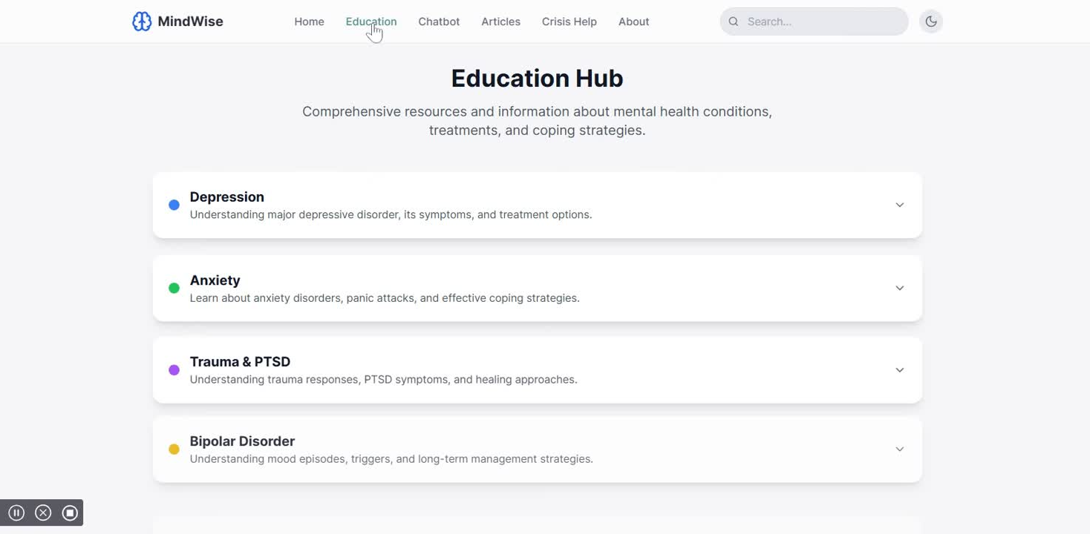
TRACTION/DEMO
Launched MVP at [Netlify Link]
Functional chatbot with scalable potential
Positive feedback from [early testers, schools, organizations]
Demo: 🔗 https://meek-sopapillas-653fbe.netlify.app/

Slide 10

WHAT WE NEED
We are seeking:
Partnerships with health orgs, universities & NGOs
Technical support to enhance personalization and data privacy
Funding for scaling, language expansion, and outreach.

Slide 11
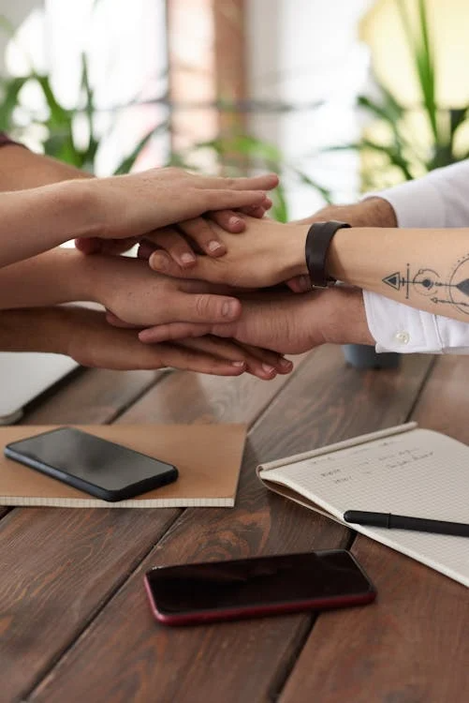
LET’S PARTNER FOR IMPACT
“Mental health is a universal human right.” – WHO 2023
Let’s make support accessible, human, and hopeful for everyone.
Contact: AI FOR SOFTWARE ENGINEERING
📩
🌐https://meek-sopapillas-653fbe.netlify.app/

Slide 12
THANK YOU
FOR COMING

